Slide 1
Targeted maximum likelihood estimation – Case control studies
Building block ideas:
Exposure-side information: The regression model for A, given confounders contains information about how X deviates from an ideal randomized design (e.g. weighting to emulate a trial)
Outcome-side information: The regression model for Y, given A and covariates contains information about the effect of A on Y (e.g. confounding or adjusting for ”blocks” in a trial)
Sampling information: Sampling fractions contain information about how each observation would be represented in a cohort study
TMLE is a union of ideas:
Cohort: if we can 1) mimic the randomized design using a and 2) adjust for covariates using b, then we can get some benefits of both actions
Case-control: If we can use c to weight the case-control data to resemble the cohort, then we can use TMLE as though we were in a cohort

Slide 2
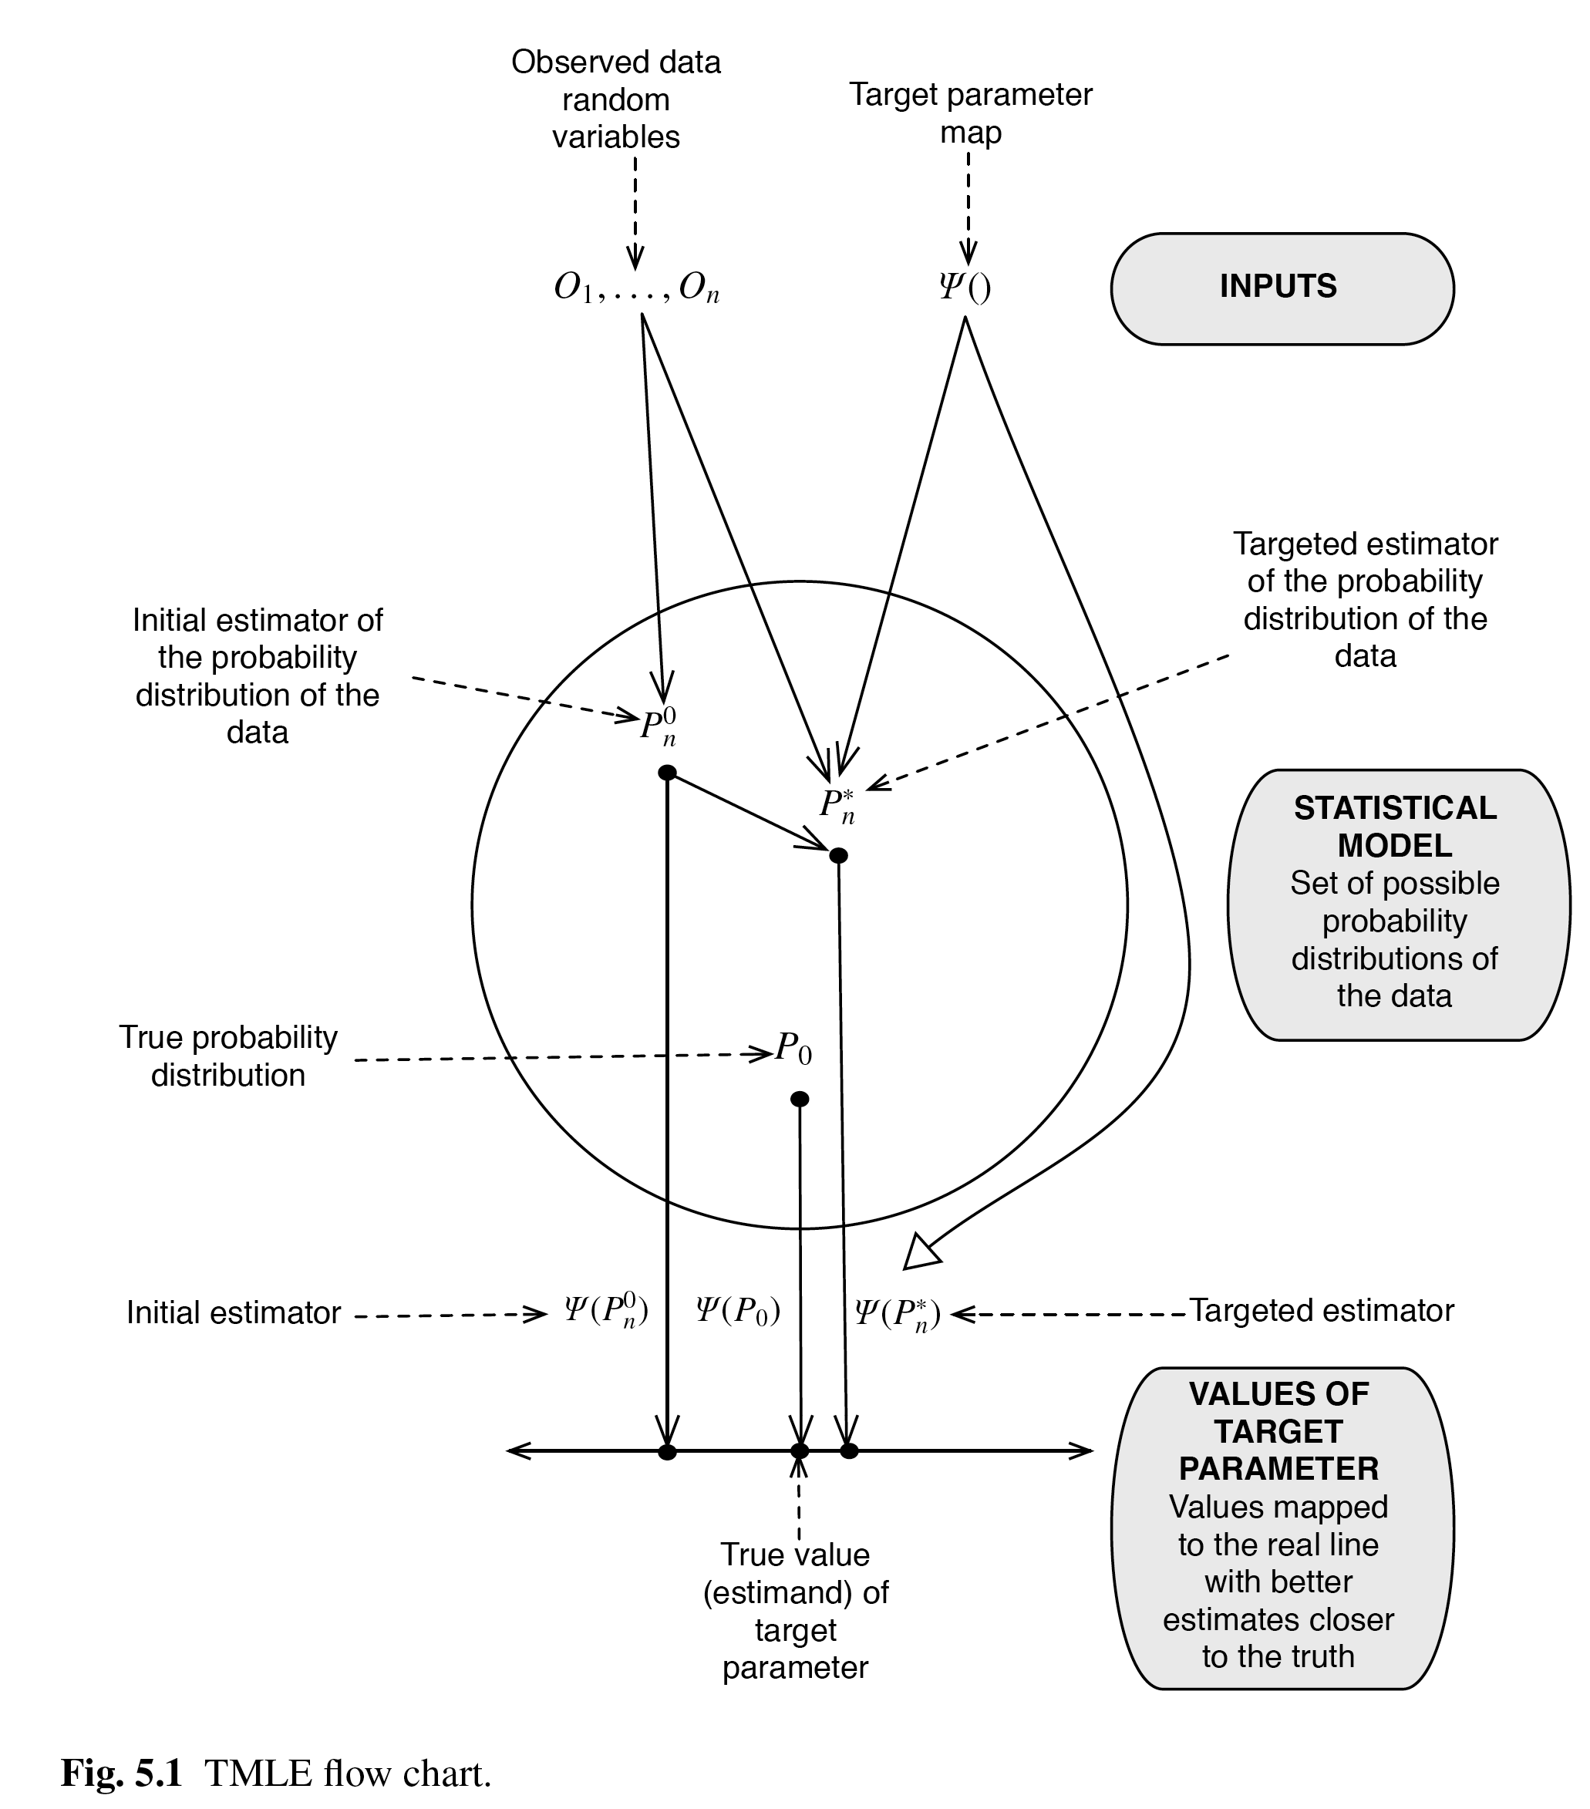
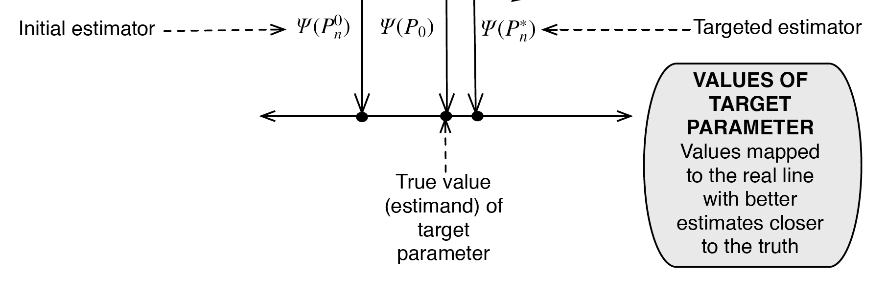
Targeted maximum likelihood estimation – Case control studies
Figure from: van der Laan and Rose.
Targeted Learning (Ch 5)
Targeted maximum likelihood estimation builds on Robins et al (1994) to develop estimators of causal effects that leverage outcome-side and exposure-side information
Derives from a simpler algorithm (which Robins and Rotnitzky does not always work):
Estimate propensity score
Regress outcome on exposures, confounders AND propensity score
Robins, Rotnitzky, and Zhao. (1994) JASA
Robins and Rotnitzky, (2001) Stat Sin

Slide 3
TMLE algorithm
Define case-control weights (using sampling probabilities)
Fit weighted model*/intercept-adjusted logistic regression and predict the outcome for each exposure/covariate combination in the data
Fit weighted model to estimate propensity scores
Compute “clever covariate” based on propensity score
Estimate “fluctuation parameter” in weighted regression of observed outcome on the clever covariate with initial prediction as offset and no intercept
Update the predicted outcome via the fluctuation parameter, average over the weighted covariate distribution

Slide 4
TMLE
TMLE is very similar in implementation to augmented-IPW, another set of doubly robust methods
  Feasible to use a very similar approach with AIPW for case-control studies
Allows many types of parameters to be estimated (OR/RR/RD)
Can be tricky to adapt to novel situations, continuous exposures
R package “tmle” helps with many standard cohort designs (we will illustrate without the package)

Slide 5
R Code
Repository of code: https://github.com/alexpkeil1/Case-control-causal-review
Instructions (assuming basic knowledge of R)
Download repository as zip file (or use git functions, if you know them)
All files use simulated examples and should work without modifications
  Data are generated by simulating a cohort and then sampling cases and controls using cumulative sampling
Code is commented for implementation details

Slide 6
Challenges and limitations of current approaches
Unknown sampling fractions
Causal odds ratios
Case/control samples can be drawn multiple ways
Time-varying confounders affected by prior exposures

Slide 7
”Causal” odds ratios
Propensity score-based methods don’t address outcome sampling bias
  Most prevalent approaches in our review
Marginal ORs not comparable to conditional ORs (comparison with literature is challenging)
Greenland challenges the notion that a conditional OR can be called “causal” (non-collapsibility)
Greenland. (1987) AJE

Slide 8
Case/Control sampling
Matched designs: generally all estimators can accommodate matching
Cumulative incidence sampling vs. incidence density sampling
  Sampling weights based on P(Y=1) or P(Y=0) are “cumulative”
  van der Laan (sort of) extended sampling weights to time-specific outcome probabilities for incidence density sampling
    Can be unstable without many tied event times
Case/control sampling in an open cohort design is possible, but causal inference for open cohorts has severe limitations (e.g. results can’t be easily interpreted as emerging from a target trial)
van der Laan. (2008) Int J Bios

Slide 9

Time-varying confounders affected by prior exposures
A fundamental problem that inspired longitudinal causal inference (Robins (1986) Math Mod)
MLE based estimators often require models for confounders (challenge: complex confounder sampling)
Confounder measurements typically assumed at regular time intervals (challenge: misaligned with sampling times)
Existing case-control study designs and analysis methods will generally not be able to accommodate these problems
Not specifically addressed in any reviewed paper, but a potential methodologic gap worth exploring

Slide 10
What is causal inference, really?
Using propensity scores or other methods?
Controlling confounding?
Marginal parameters?
Non-model-based parameters?
Target trial/new user designs?

Slide 11
Closing thoughts
The methods of causal inference have been *heavily* focused on closed cohorts
Case-control studies still have a place for understanding impacts of emergent exposures and diseases with long latency (e.g. cancer outcomes)
Existing methods yield helpful data summaries of existing case-control studies, but addressing temporality and other aspects like time-varying confounding may require novel study designs

Slide 12
Thank you

